Slide 1
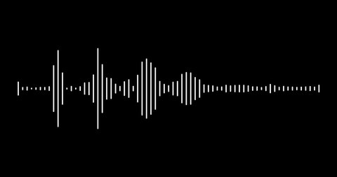
Digital Signal Processing Project
Active Noise Cancellation
EE21B040 Poornachandra Giridhar
EE21B054 Sudhakar V

Slide 2
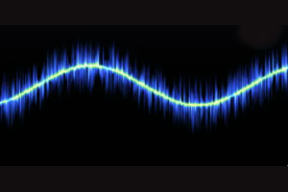
What is noise?
Noise is an unwanted sound that is unpleasant, loud, or disruptive. Other words for noise include buzz, cacophony, commotion, crash, cry, explosion, roar, or turbulence.

Slide 3
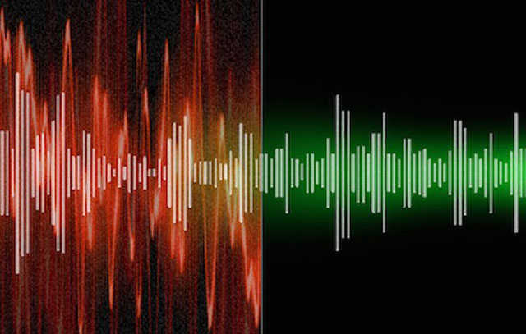
Why Noise Cancellation?
Excessive noise exposure can induce hearing impairment, psychosocial effects such as annoyance, stress-related health effects such as cardiovascular disorders, sleep disturbance, and decreased school performance.

Slide 4
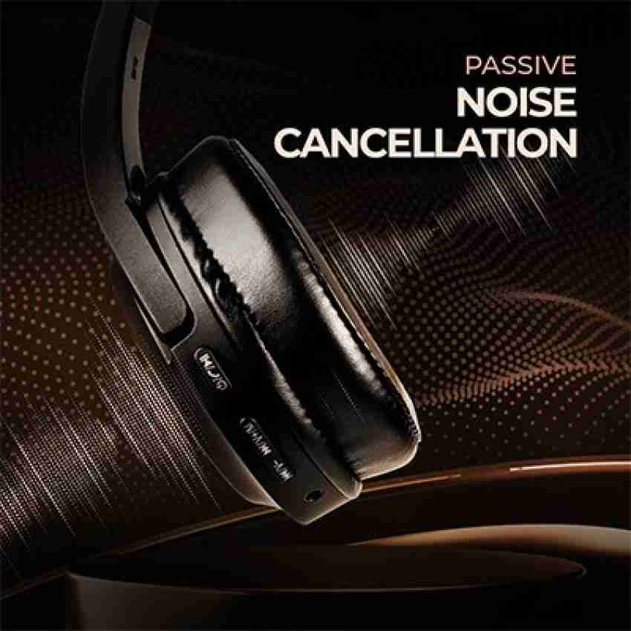
Passive Noise Cancellation
Uses well-designed ear cups to seal out unwanted noise. This is used for both over-ear headphones and in-ear earphones where the earbud itself will keep surrounding noise out.

Slide 5


Slide 6
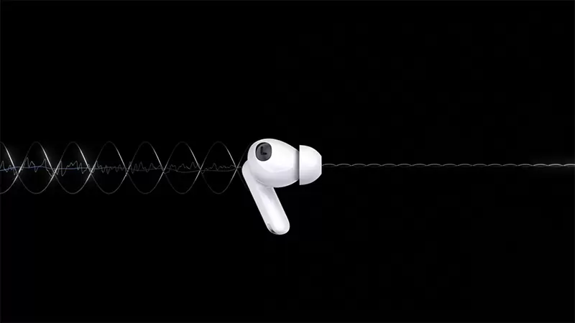
Active Noise Cancellation
Uses microphones and speakers to reduce background and surrounding noises. This is the most known type and has mostly been used in over-ear headphones. Technology has become so small and battery efficient now that it can be used in true wireless in-ear earphones.

Slide 7
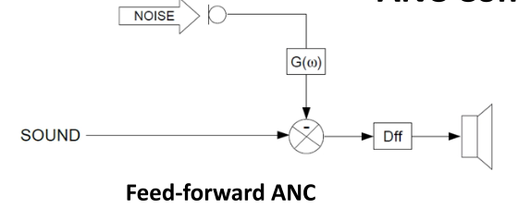
Types of Active Noise Cancellation Techniques
Feedforward Active Noise Cancellation
Here, the mic is outside the ear cup, and hears the outside noise before you can. It then processes the intrusive noise to create the anti-noise waves to cancel or neutralize the former so you can enjoy the sound. if the headphones or the earphones are not placed properly and can amplify the noise outside.

Slide 8
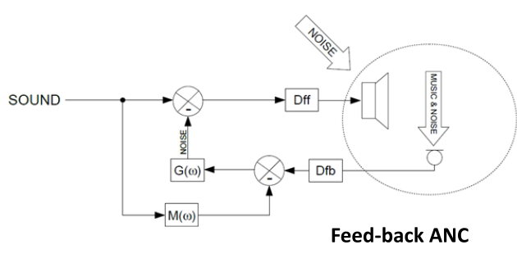
Feedback noise cancellation
In this type of cancellation, the mic is inside the ear cup and in front of the speaker, so it gets to hear the resulting signal in the same way the listener does. And if the headphones or earphones are worn incorrectly, it does not drastically affect the sound canceling.

Slide 9
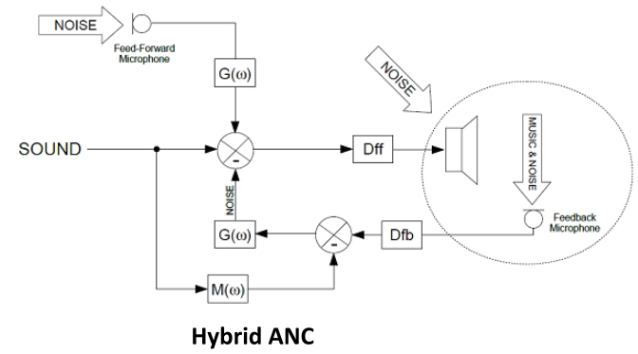
Hybrid Noise Cancelation
This is the combination of both Feedforward and Feedback noise cancellation

Slide 10
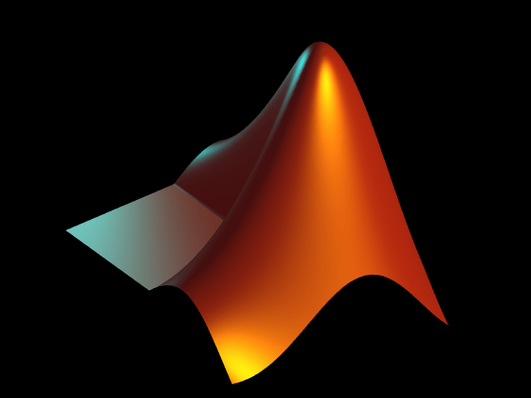
Simulink-Based Model
Simulink is a powerful simulation and modeling tool. It allows users to design and implement complex real-time algorithms for ANC systems, ensuring optimal noise reduction performance. With Simulink, you can seamlessly integrate ANC algorithms into various applications and achieve superior audio quality by effectively eliminating unwanted background noise.

Slide 11
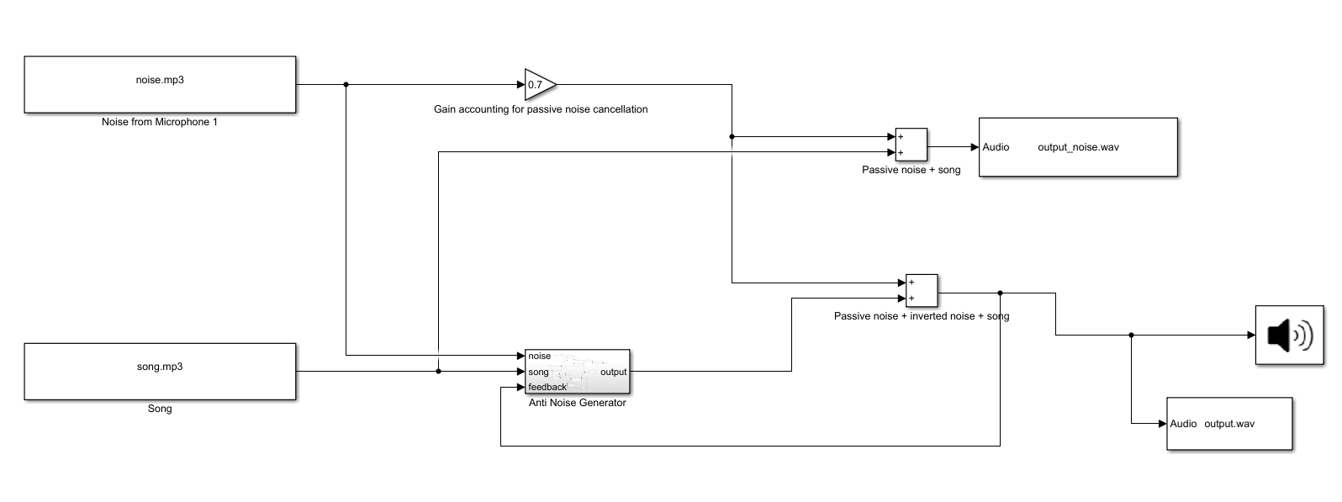
The Model in Simulink

Slide 12
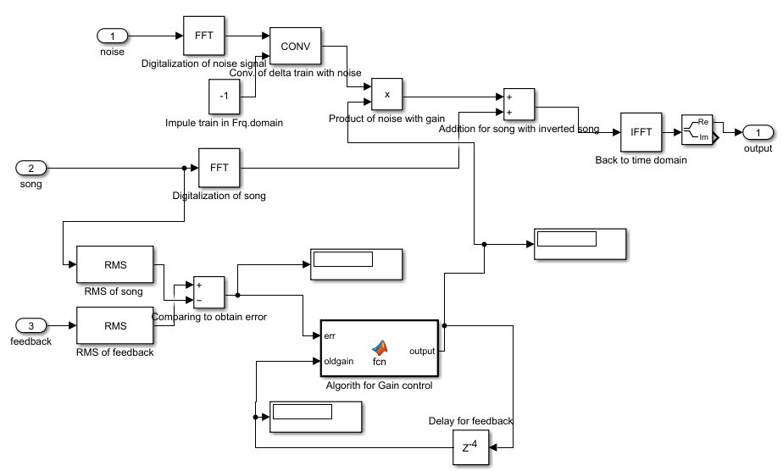
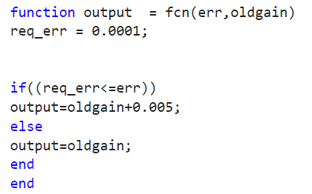
The Model in Simulink
The code
Inside the Anti Noise Generator

Slide 13
Features of the model
The complete system is meant to be implemented using a minimum digital processor and electrical components.
Despite passive noise attenuation via foam ear-speaker isolation, the system automatically adjusts its noise cancellation gains. This was done via closed-loop feedback.

Slide 14
Limitations of the Model
The simulation breaks when the output is very close to the desired output because MATLAB's ODE and DAE solve algebraic loops using prediction algorithms and iterations, which break for very small error values. Add the delay block from output to old gain to avoid a straight feedthrough loop. Simulation breaks in such a scenario and the delay value is estimated after several trial-and-error rounds.
Due to the nature of logic written for changing gain, if in case passive noise attenuation changes considerably, the system needs to be restarted.

Slide 15


Slide 16
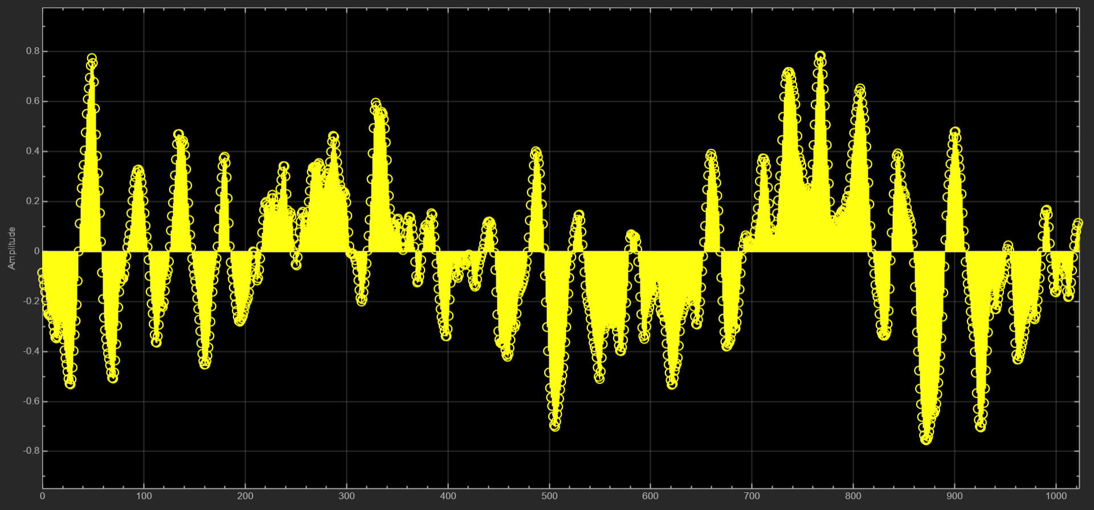
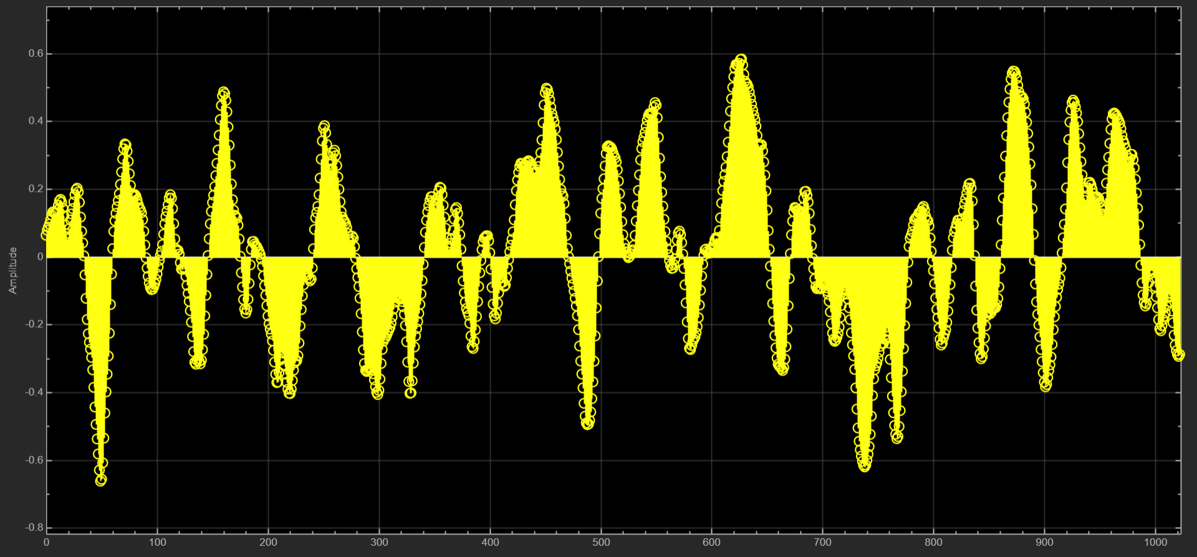

Noise Signal
Anti-noise signal with actual signal

Slide 17
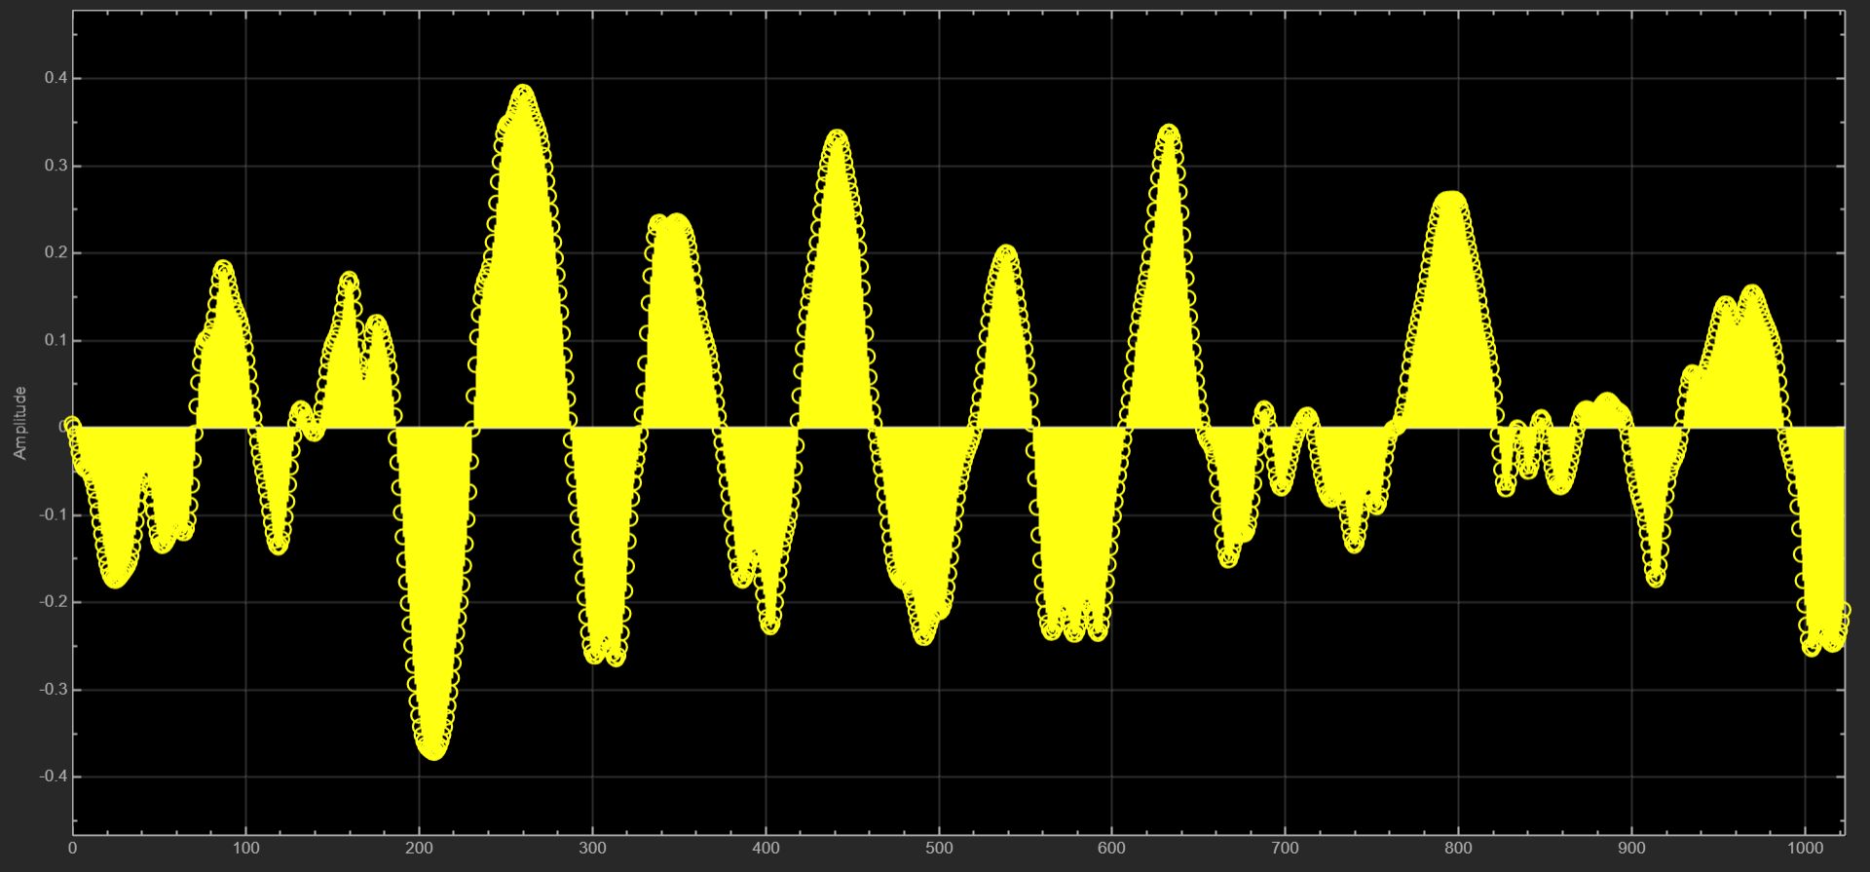
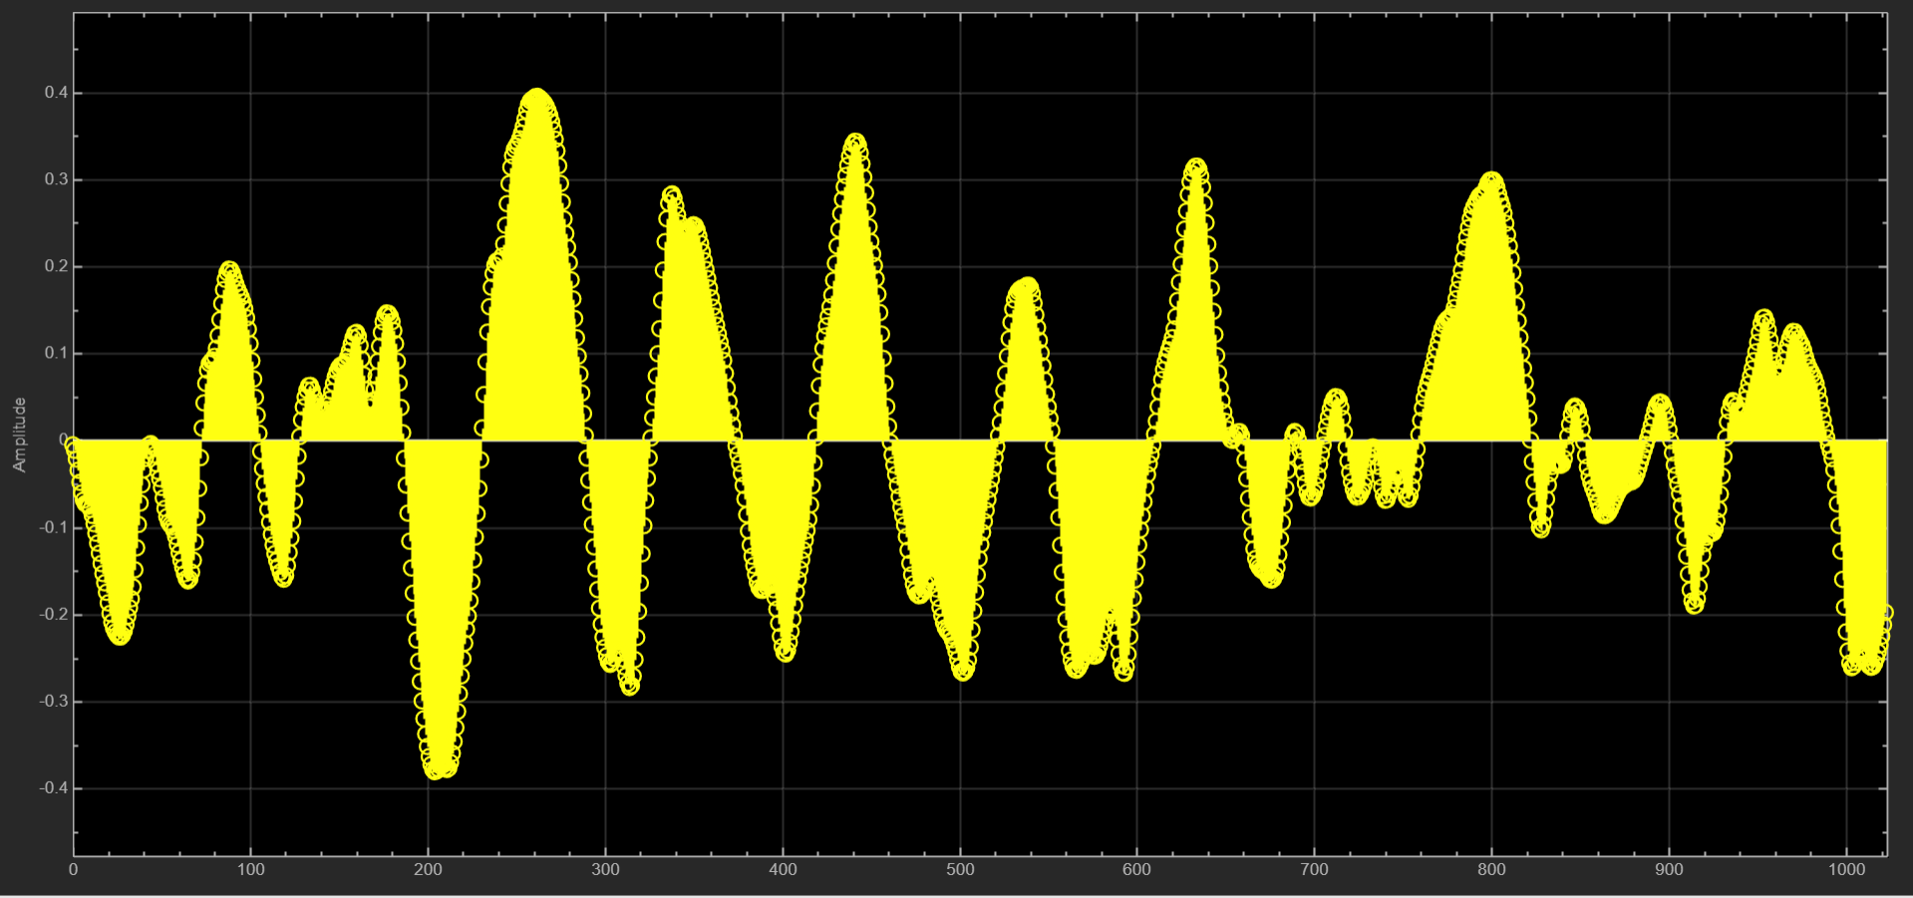
Actual clean Audio Signal
Denoised Audio Signal

Slide 18
Thank You

